Slide 1

Project Title -Seasonal Agriculture Performance Analysis
Student Name – K. Hasini Vihagna
College Name - Kakatiya Institute of Techonology and science
AICTE STU ID : STU6a2c1f983c5c01781276568

Slide 2

PROBLEM STATEMENT
Agricultural activities are influenced by seasonal variations in environmental conditions, farming practices, resource availability and market conditions. As a result, agricultural performance may differ from one season to another. However, raw agricultural data does not clearly explain how agricultural performance changes across seasons or what patterns can be observed in different seasonal conditions. The problem is to analyze the given agricultural dataset and investigate seasonal differences in agricultural performance by identifying meaningful patterns, trends, relationships and variations within the available data.

Slide 3
Project Description
Seasonal Agriculture Performance Analysis is a data analytics project that studies agricultural performance across
different seasons, crops, and regions.The project analyzes factors such as rainfall, temperature, humidity, soil
conditions, fertilizer usage,water consumption, and disease risk.It examines how these seasonal and
environmental factors affect crop yield, production, revenue, costs, and profit.Statistical analysis and
visualizations are used to identify important patterns, trends, relationships,and variations in agricultural
performance.The project also compares crops, irrigation methods, and seasonal performance to
identify the best-performing combinations.The final outcome is a seasonal agriculture dashboard that
provides data-driven insights to support better agricultural planning and decision-making.

Slide 4

WHO ARE THE END USERS?
Agricultural officers
Farmers
Agriculture Planners & Policymakers
Agribusinesses
Researchers & analysts

Slide 5

Technology Used
Python
Google Colab
Pandas
NumPy
Matplotlib
Seaborn

Slide 6
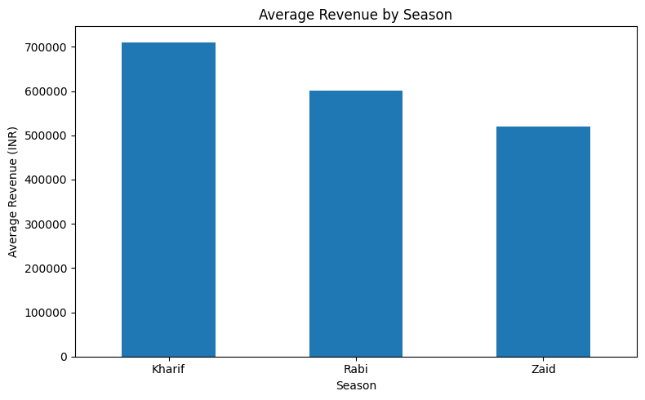
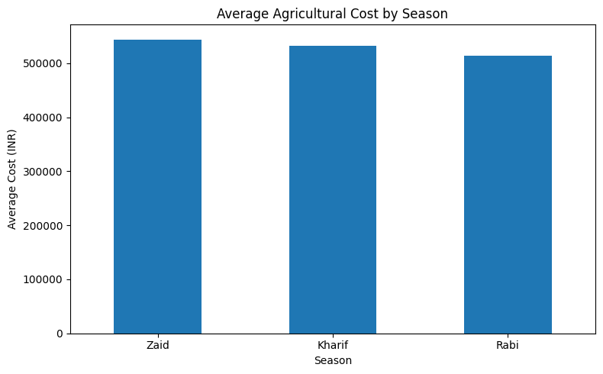
RESULTS

Slide 7
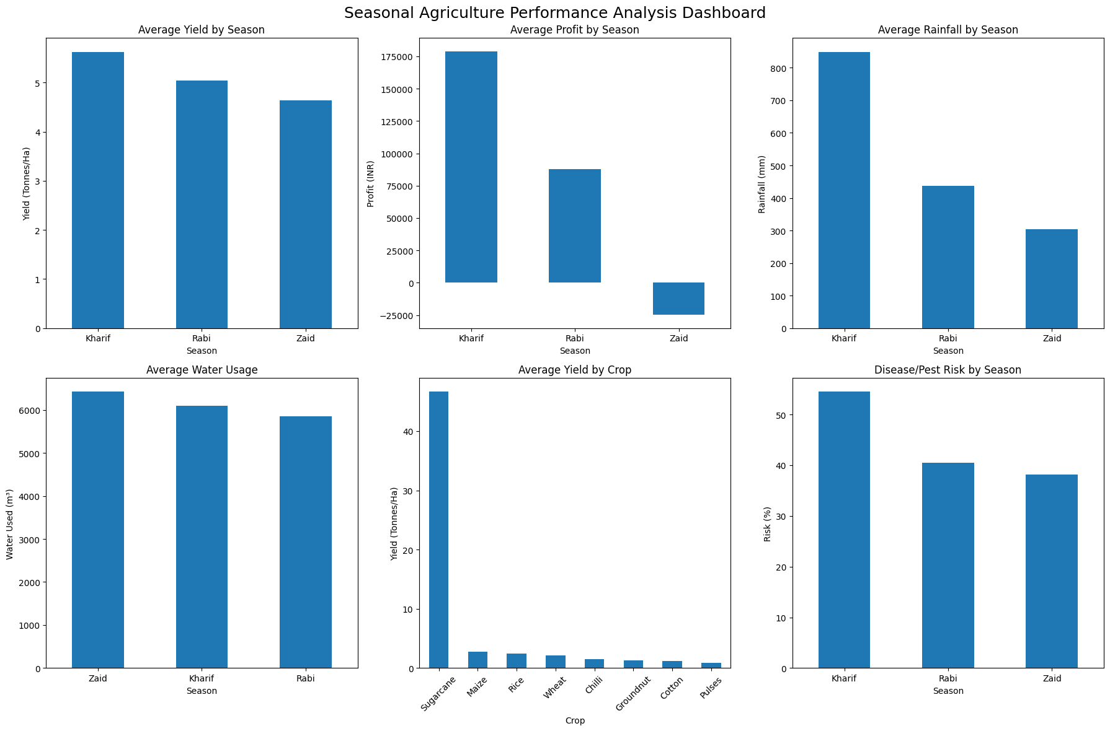
RESULTS
[Add screen shots of your code ]

Slide 8
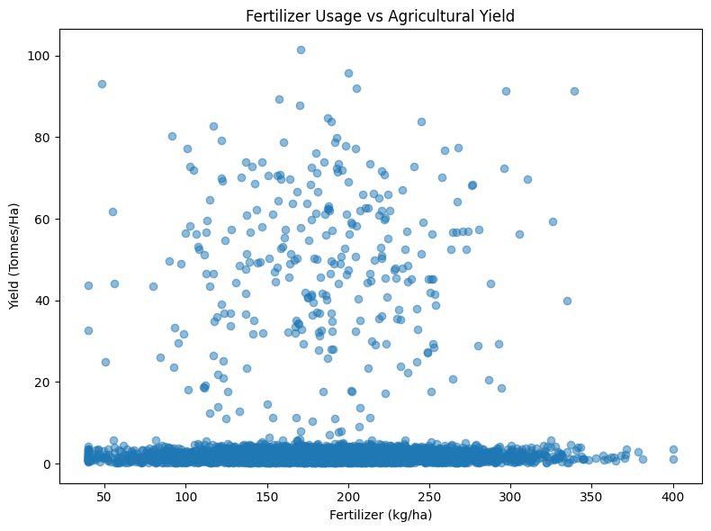
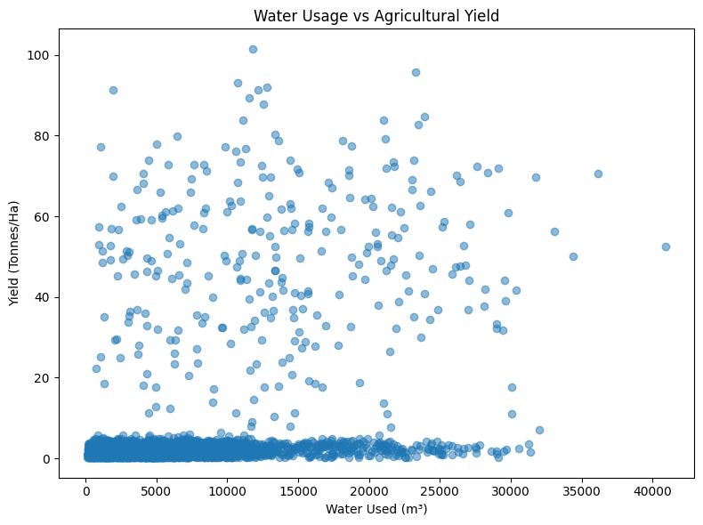
RESULTS
[Add screen shots of your code ]

Slide 9
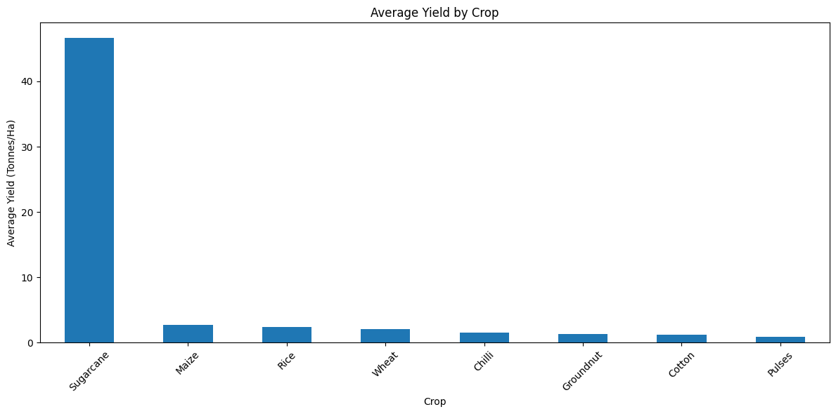
RESULTS
[Add screen shots of your code ]

Slide 10
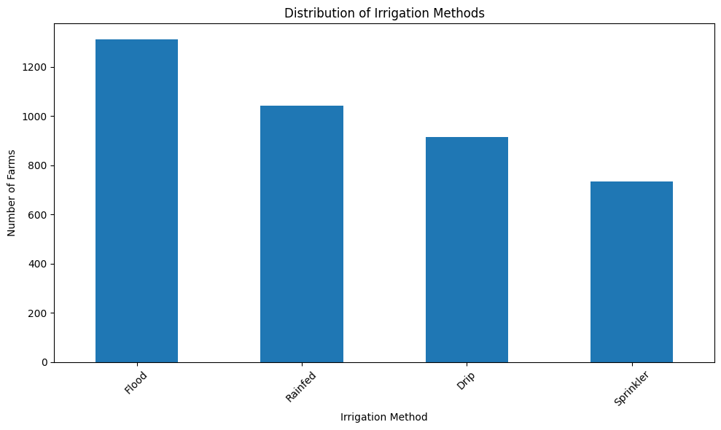
RESULTS
[Add screen shots of your code ]

Slide 11
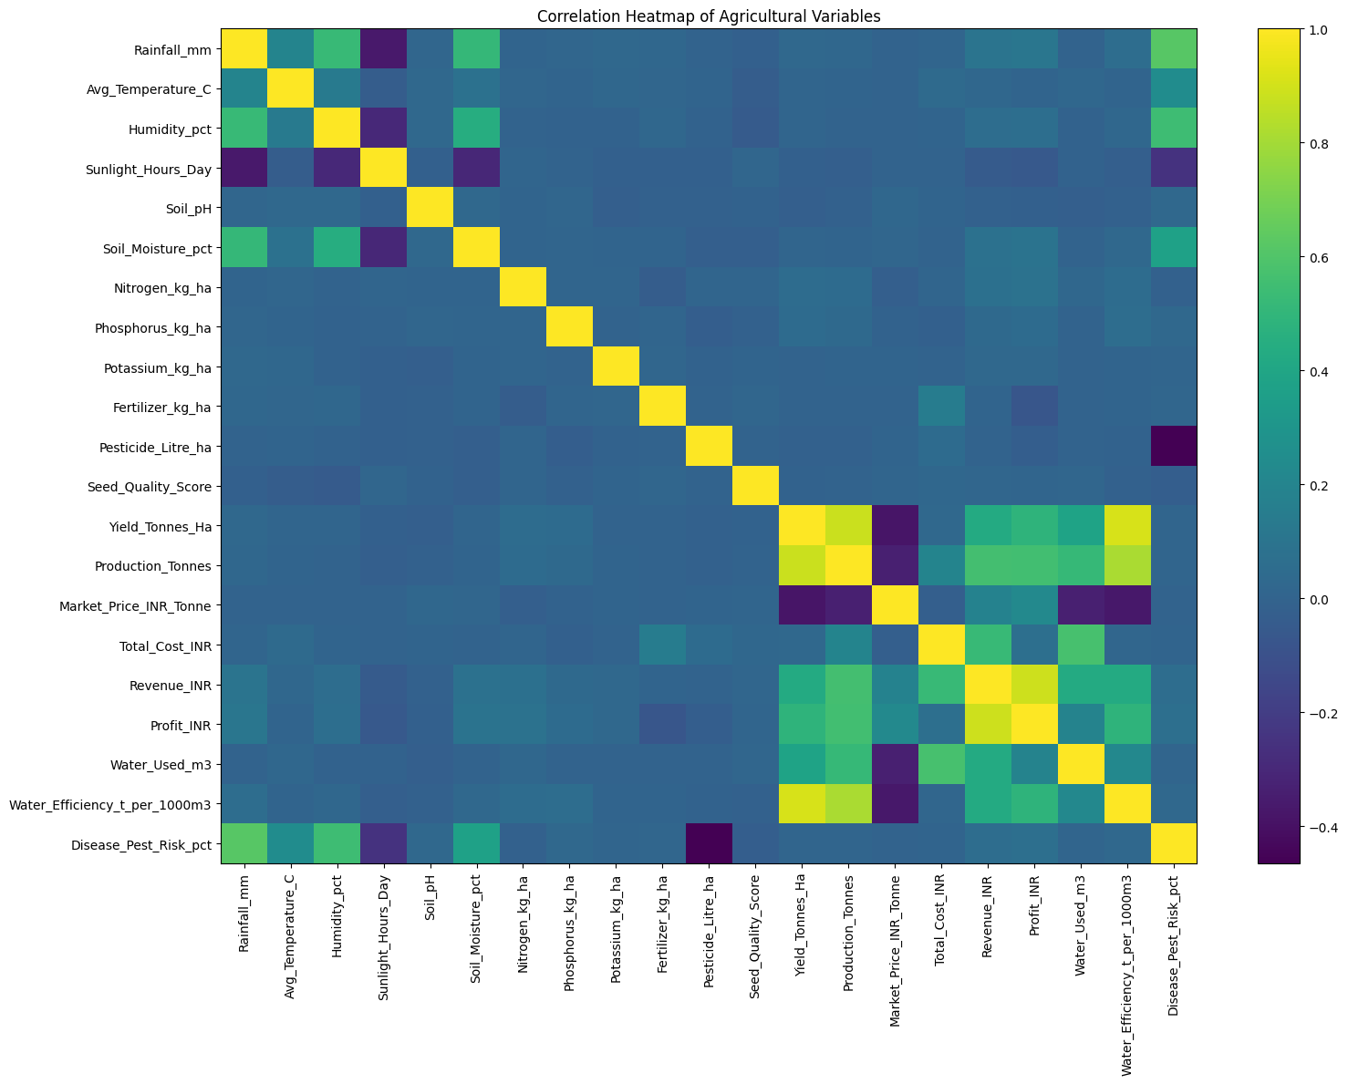
RESULTS
[Add screen shots of your code ]

Slide 12
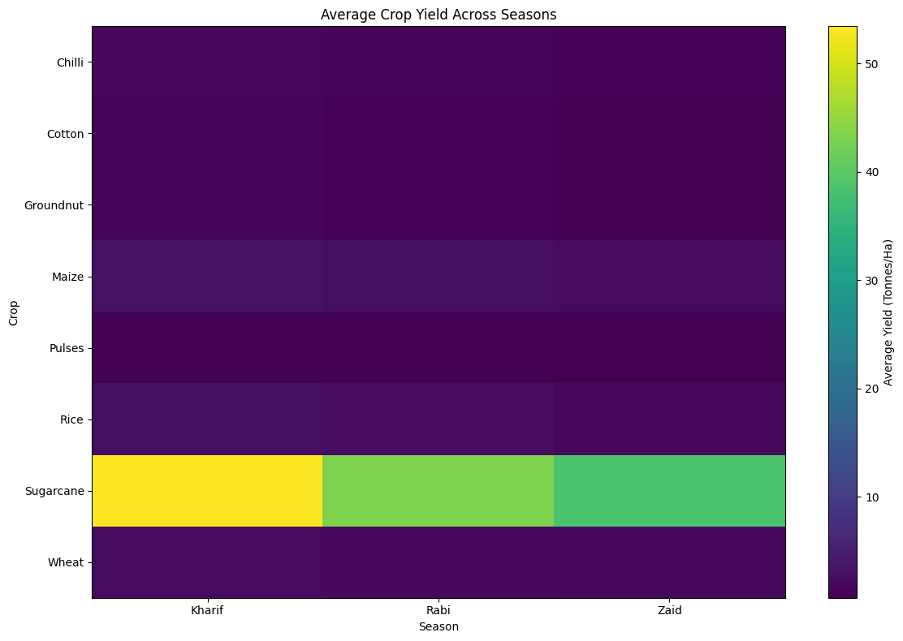
RESULTS
[Add screen shots of your code ]

Slide 13
Future scope
Future versions can include real-time market price analysis to help farmers improve profitability.
The dashboard can be developed into an interactive web or mobile application for easier access by
farmers and agricultural officers.
The system can provide early warnings for disease and pest risks.
A crop recommendation system can suggest suitable crops based on soil and seasonal conditions.
Machine learning models can be added to predict crop yield and agricultural performance.
The project can be extended to include real-time weather and climate data for more accurate seasonal
analysis.

Slide 14
GitHub Link
https://github.com/Viha07/-Seasonal-Agriculture-Performance-Analysis-.git

Slide 15
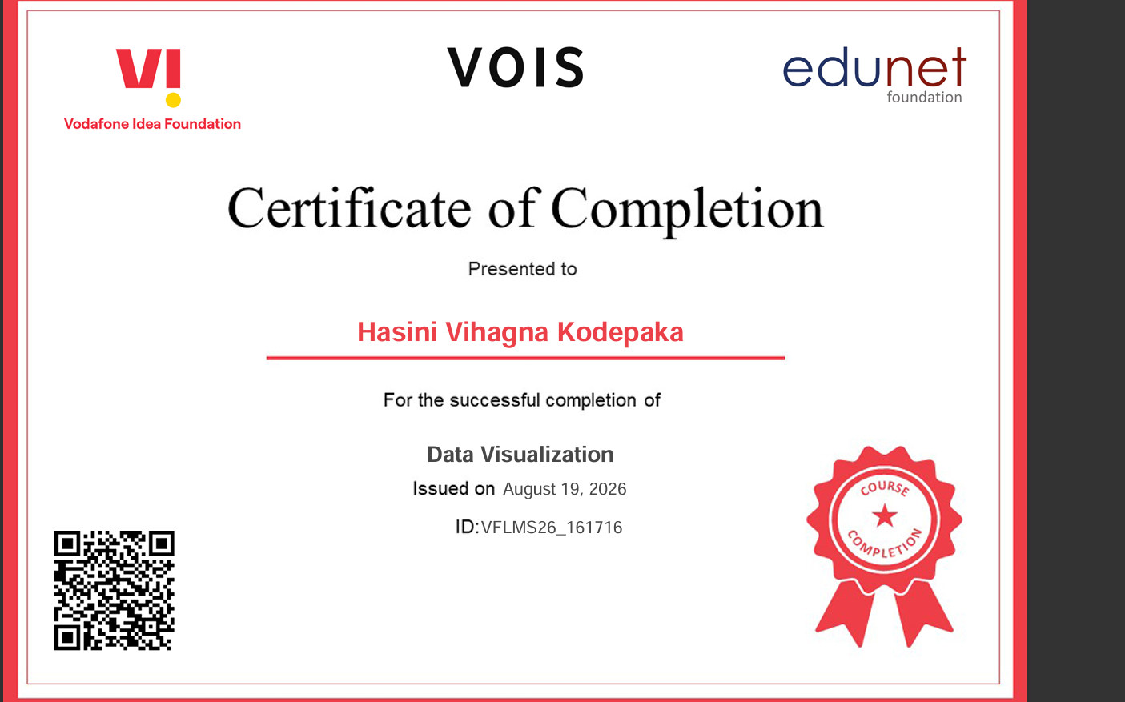
VOIS Course completion certificate - Course name- Data Visualization

Slide 16
Thank you
.
.

